Slide 1


Title of the Project:-
“Real Time Incubator Monitoring System Using Wireless Network”
Presented by:Group Name-TG31
Pravin M Malashetti (1BY20EC125 )
Swathika M (1BY20EC194)
Mohammed saqib (1BY20EC101)
Rishabh Jaiswal (1BY20EC136)
Under the Guidance of
Dr. Rashmi N
Assistant Professor

Slide 2



Introduction
An IoT-based baby incubator is a life-saving device that provides a controlled environment for premature babies. It monitors vital signs and alerts doctors in case of any abnormalities.Real time data collected from the sensors is transmitted in real-time to a dedicated website, allowing medical professionals and parents to remotely monitor the baby's well-being.

Slide 3

Problem statement
Design an Internet of Things (IoT) device for baby incubator that provides a controlled environment with real-time monitoring of temperature, humidity, and oxygen levels to ensure the well-being of premature infants.

Slide 4

LITERATURE SURVEY
D A Ducker, A J Lyon, R Ross Russel, C A Bass, and N McIntosh,Incubator temperature control: effects on the very low birth weight infant, Department of Child Health, St George's Hospital Medical School, London, 60, 902-907,1985.
Djaaffar Bouattoura, Pierre Villon, and Gilbert Farges,Dynamic Programming Approach for Newborn’s Incubator Humidity Control IEEE Transactions on Biomedical Engineering, VOL. 45, NO. 1, January 1998.
N.S. Joshi, R.K. Kamat, P.K. Gaikwad, Devolopment of Wireless Monitoring System for Neonatal Intensive Care Unit (NICU), International Journal of Advanced Computer Research Volume-3 Number-3 Issue-11 September-2013.
Sowmyasudhan S, Manjunath S, A Wireless Based Real-time Patient Monitoring System, Volume 2, Issue 11, International Journal of Scientific & Engineering Research, November2011.
Erik Grönvall, Luca Piccini, Alessandro Pollini, Alessia Rullo, Giuseppe Andreoni, Supporting inspection strategies through palpable assemblies, University of Siena, Communication Science Department, Via Roma 56,53100 Siena, Italy.

Slide 5
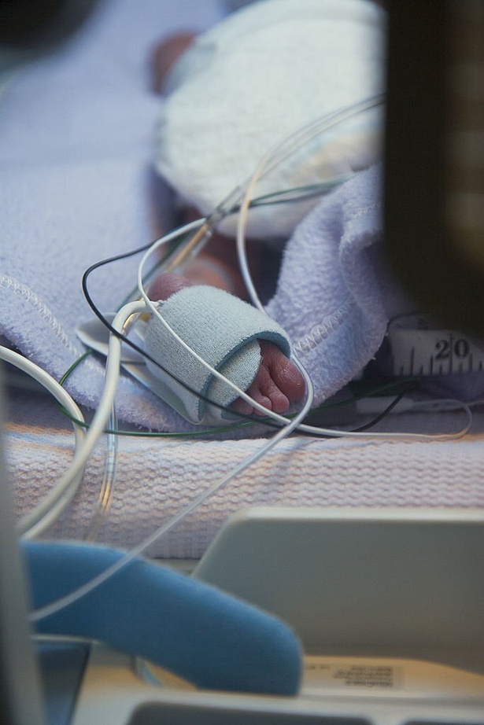
LITERATURE SURVEY
Karan Kolla, Rakesha R, Tejus S, Narendra Kumar G and Alice Abraham, Real Time Incubator Monitoring System Using Wireless Sensor Network, Dept. of Electronics & Communication, UVCE,Bangalore University, INDIA.
Chandra sekar.G, Assistant Professor, Dept. of ECE, SRM University, Ramapuram, Chennai, India, Design and Development of an Infant Incubator for Controlling Multiple Parameters
Wei Chen, Son Tung Nguyen, Roland Coops, Wireless transmission design for health monitoring at neonatal intensive care units, Conference Paper, December 2009
Phond Phunchongharn and Ekramm Hossain et. al, A Cognitive Radio for E-Health Applications in A Hospital Environment University of Manitoba Dusit Niyato, Nanyang Technological University Sergio Camorlinga, UNIVERSITY OF MANITOBA AND Trlabs IEEE Communications, February 2010.
Amit M. Mathur & Jeffrey J. Neil & Robert C. McKinstry & Terrie E. Inder, A ServiceBased Perspective on Neonatal Critical Care

Slide 6
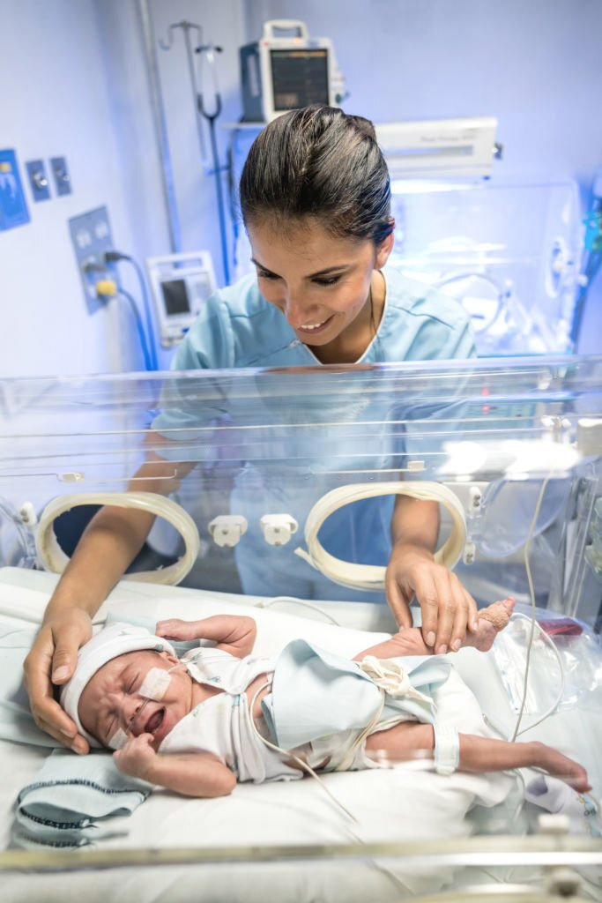
Motivation
The motivation for the Smart Baby Incubator project comes from the need to address the high rates of premature births and the associated risks and complications that premature infants face.
Premature babies require specialized care and monitoring, including precise control of temperature, humidity, and oxygen levels, to promote healthy growth and development.
The Smart Baby Incubator project aims to provide a safe, sterile, and nurturing environment that promotes the health and well-being of premature infants.
It is also important to provide parents with real-time monitoring and remote access to the incubator system to reduce stress and anxiety while allowing them to stay connected to their baby's care.

Slide 7

Objectives
Develop an easy-to-use system for NICUs.
Cost-effective: Utilizes Arduino microcontroller and sensors.
User-friendly: Provides remote access to live data through website.
Optimal environment: Regulates environmental conditions for baby's growth and development.
Real-time monitoring: Allows doctors and parents to stay informed and make timely decisions.
Improves quality of care: Enhances effectiveness of NICU care and reduces risk of complications for premature babies.

Slide 8
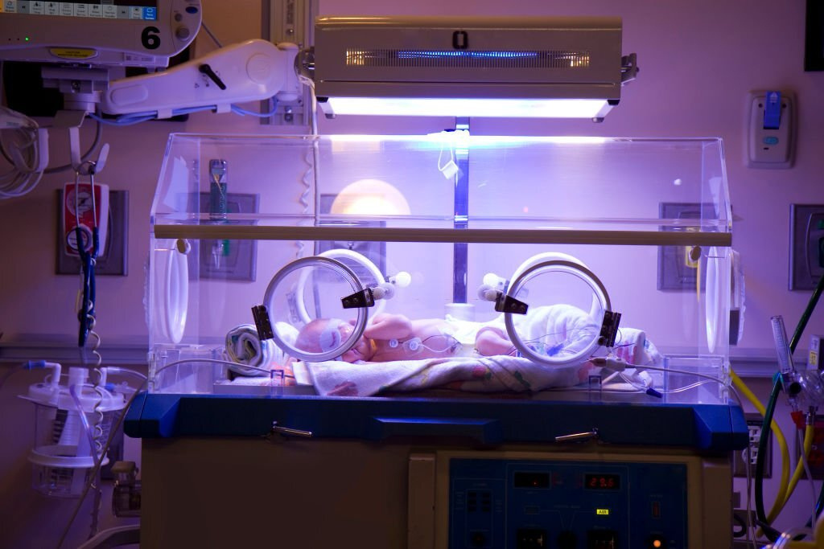
Methodology
Scope of present work:
System design: Designing the system architecture, including the selection of sensors and development board and integrated into the system to monitor environmental conditions.
System testing: The system is tested to ensure that it can accurately monitor and regulate the environmental conditions inside the incubator.
User interface development: A user-friendly interface is developed to display the data collected by the sensors and allow users to remotely access the system through a website.
Integration with existing infrastructure: The system is designed to integrate with existing hospital infrastructure and protocols, including electronic health record systems.
Live data monitoring: The system provides real-time data monitoring on the website so that doctors and parents can stay informed about the baby's condition.

Slide 9
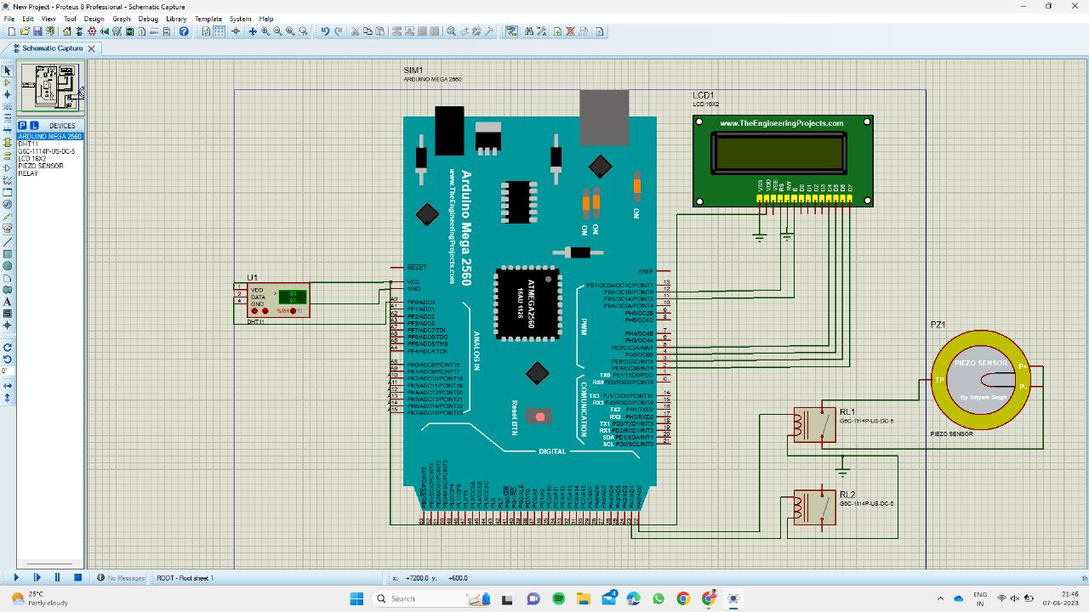
Circuit Diagram

Slide 10
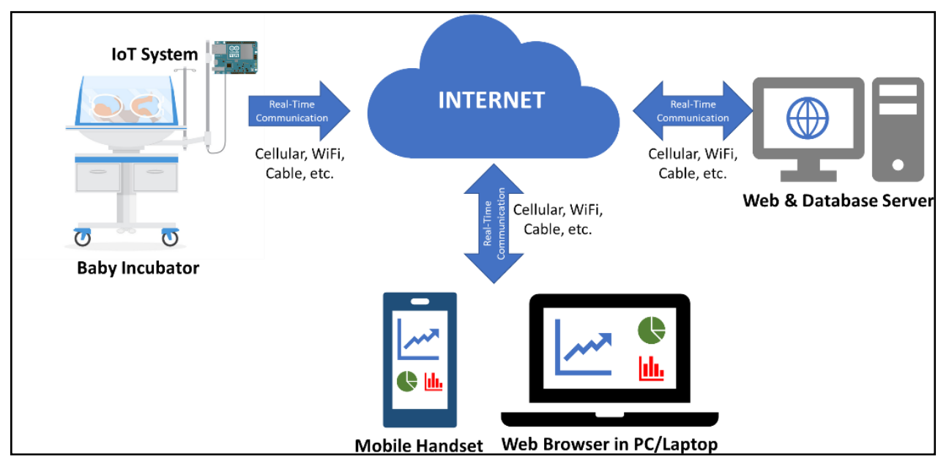
Reference Diagram

Slide 11
Identification of components
(Hardware/Software)
Microcontroller: The Arduino Uno is a good choice for this project as it has enough digital and analog pins to connect and control various sensors and actuators.
Crystal: A 16MHz crystal oscillator is used to provide accurate timing microcontroller.
LCD: A 16x2 LCD display is used as a user interface to display environmental data and system status.
ESP01: The OV2640 camera module with an ESP32-based board is used to provide remote monitoring capability through a website.
Temperature/Humidity Sensor: The DHT11 sensor is used to measure the temperature and humidity inside the incubator. Alternately, more accurate DHT22 or SHT31 sensors can also be used.
Fan: A 12V DC fan is used to regulate the temperature inside the incubator. A low noise and energy-efficient fan are recommended for the comfort of the baby.
Humidifier: A piezoelectric humidifier is used to regulate the humidity inside the incubator. Alternately, an ultrasonic humidifier or atomizer can also be used.
Relay: A 12V DC relay with a coil is used as a switch to control the humidifier and fan.
Power Source: A 12V 1A DC battery is used as a power source for the system. A rechargeable and long-lasting battery is recommended for uninterrupted operation.

Slide 12
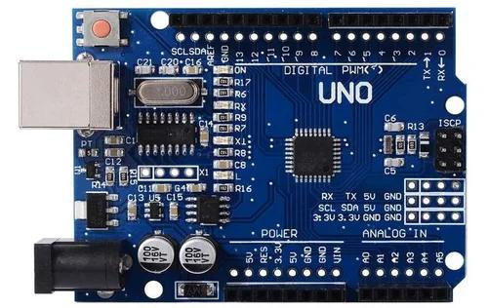
Arduino uno-
The Arduino Uno is a versatile microcontroller board with features including a 16 MHz ATmega328P microcontroller, 14 digital I/O pins, 6 analog input pins, USB interface for easy programming, flexible power supply options, compatibility with shields for added functionalities, and support for the Arduino IDE. Its simplicity, extensive documentation, and large community make it a popular choice for prototyping and educational projects.

Slide 13
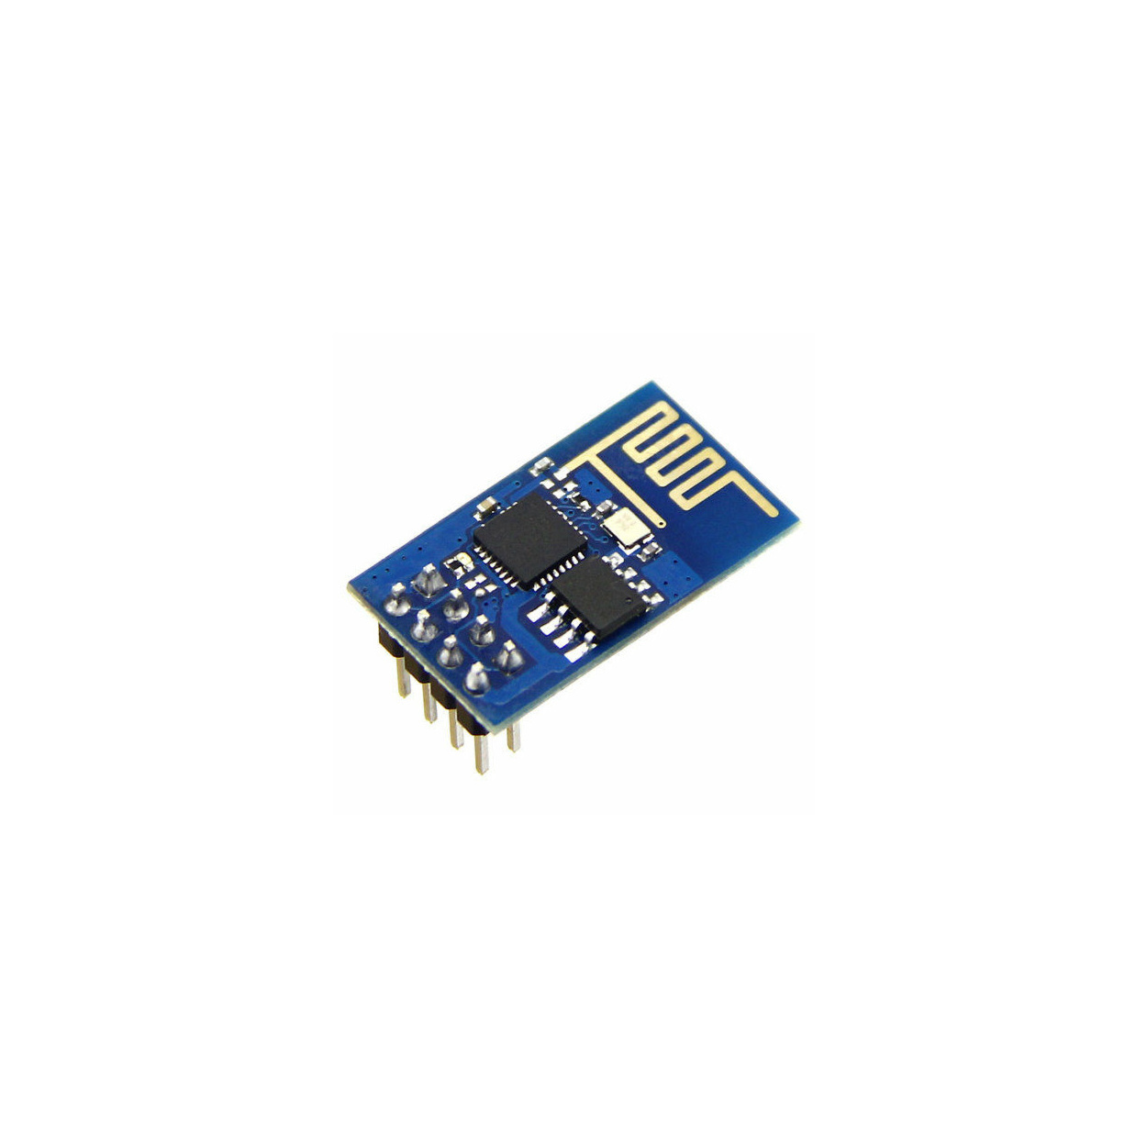
ESP01 -
The ESP01 is a small and affordable Wi-Fi module based on the ESP8266 microcontroller. It offers built-in Wi-Fi capabilities, GPIO pins for sensor interfacing, and a UART interface for communication. It requires a stable 3.3V power supply and can be programmed using the Arduino IDE or other compatible environments. The module enables wireless connectivity, making it suitable for IoT applications and data acquisition from sensors. The ESP8266 ecosystem has a strong community support system with extensive documentation and resources for developers.

Slide 14
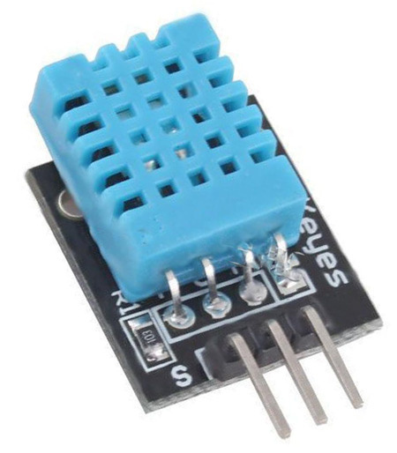
DHT11 Temperature-
The DHT11 temperature and humidity sensor is a low-cost digital sensor that can measure temperature and relative humidity with high accuracy. It has a simple 3-pin connection interface and communicates with microcontrollers using a single-wire digital protocol. The sensor provides a temperature range of 0-50°C with a ±2°C accuracy and a humidity range of 20-90% with a ±5% accuracy. It is commonly used in various applications such as weather monitoring, indoor climate control, and agriculture.

Slide 15
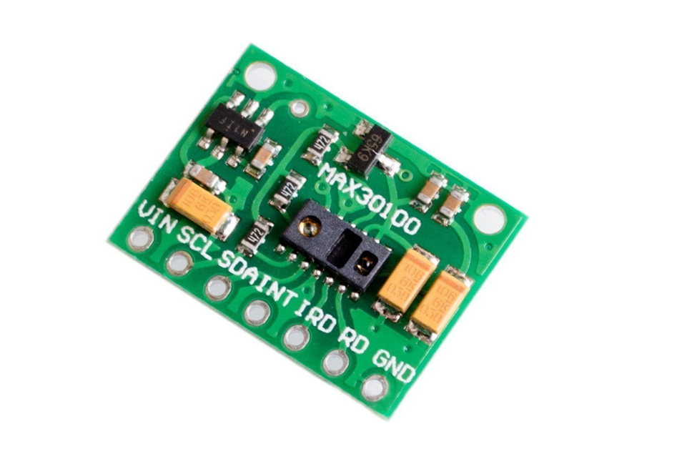
MAX30100 Heart Rate Pulse Oximetry Sensor Module
The MAX30100 is an integrated pulse oximetry and heartrate monitor sensor solution. It combines two LEDs,a photodetector,optimized optics, and low-noise analog signal processing to detect pulse oximetry and heart-rate signals.
The MAX30100 operates from 1.8V and 3.3V power supplies. This allows the power supply to remain connected at all times and avoids unnecessary power consumption.

Slide 16
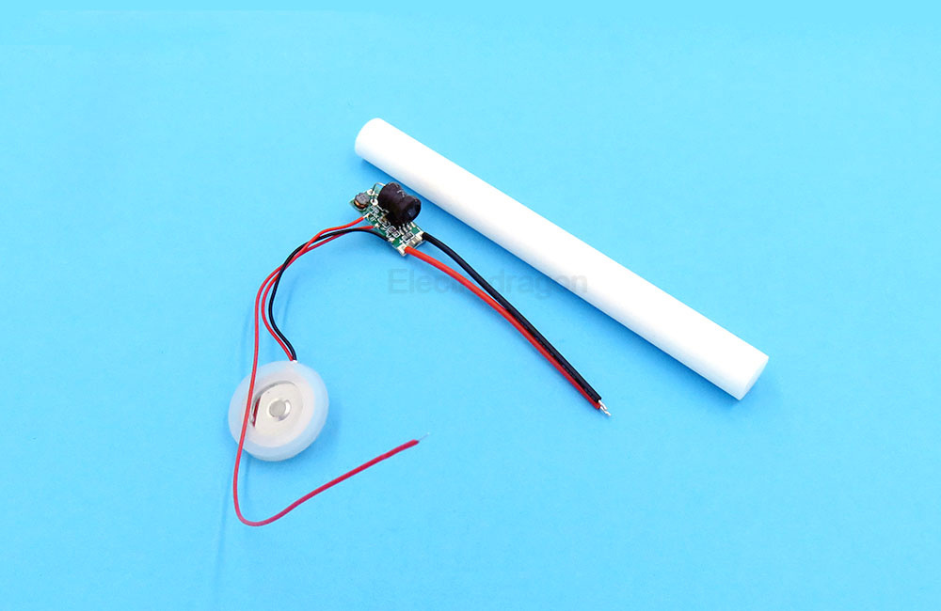
5V Humidifier Solution With Water-Level Sensor
The 5V Humidifier Solution is a system designed to provide a safe and efficient humidification process. It incorporates a water-level sensor that detects the water level and automatically stops the operation to protect the circuits from damage. The solution is designed to be submerged in water, but it does not come into direct contact with the atomized disk, which operates at high voltage. This solution can be utilized in various applications, including humidifiers, water replenishers, aroma diffusers, and other liquid atomization products, ensuring reliable and protected operation while maintaining the desired level of humidity in the environment.

Slide 17
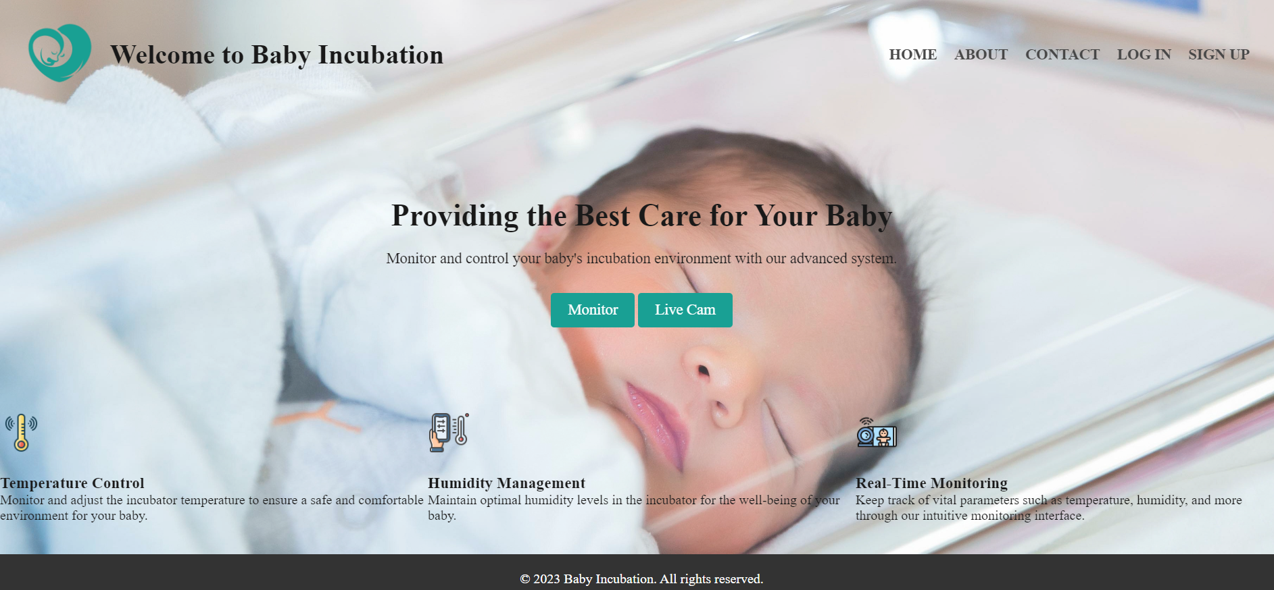
Results:

Slide 18
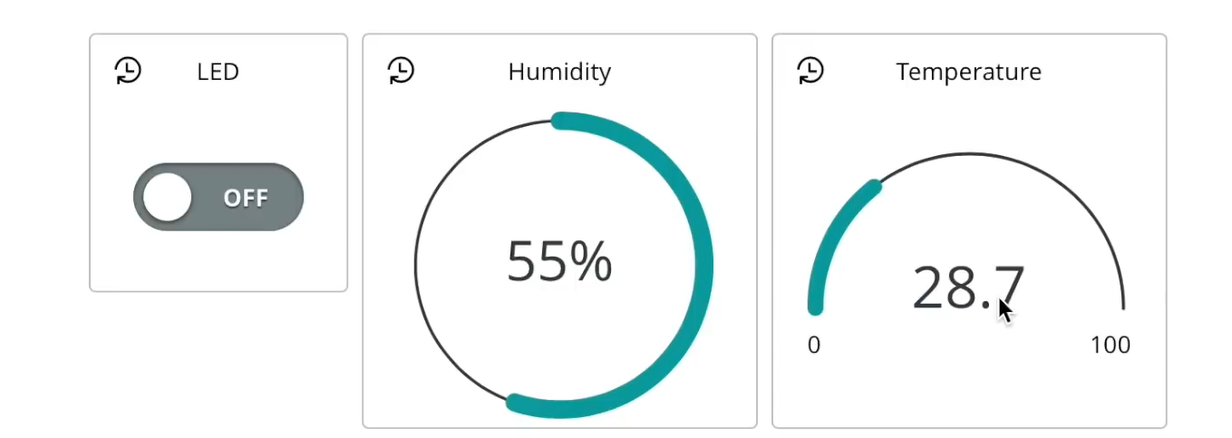
Results:

Slide 19
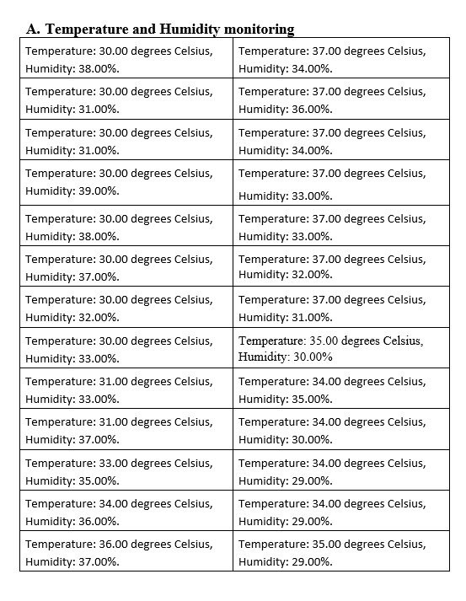
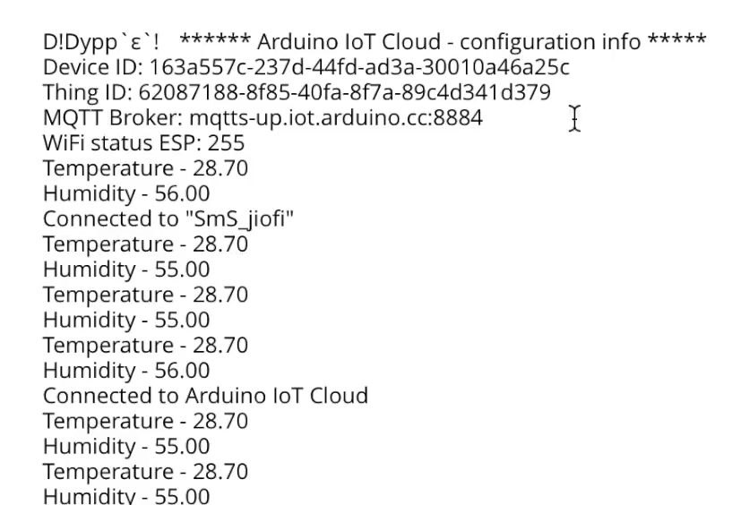
Results:

Slide 20
Conclusion
The proposed system monitors Oxygen levels of the infant and temperature and humidity of the surrounding. Temperature monitoring is done in order to keep the environment suitable for the neonate. Temperature monitoring of the infant’s body will help to detect many other internal diseases like infections, common cold, and pneumonia, have a common symptom of fever as the body temperature goes high. Humidity measure values also help in the detection of having internal problems like cold, dehydration. But the temperature inside the incubator loose due to atmosphere or any other problems, the heating pad will automatically on. And also, for continuous monitoring there should always have the facilities of power supply. But in many places, there is still have the problem of power cut about several hours.

Slide 21
FUTURE SCOPE
The future work is focused on the implementation of the monitoring system to monitor all the pathological parameters of infants in all the hospitals with common physician/consultant.
In future, many implementations can take place, like ECG monitoring, proper oxygen supply controlling and above all the controlling system will automatically on or off.
As there will be given a particular set point for different parameters, the controller will automatically on if the measuring value goes below the set value and the controller will automatically off if the measuring value goes high compare to the set value.
There is also a possibility of replace the power source by solar cell. In rural area there is a big problem in supplying of electricity. So, this problem will also overcome in future implementations.

Slide 22

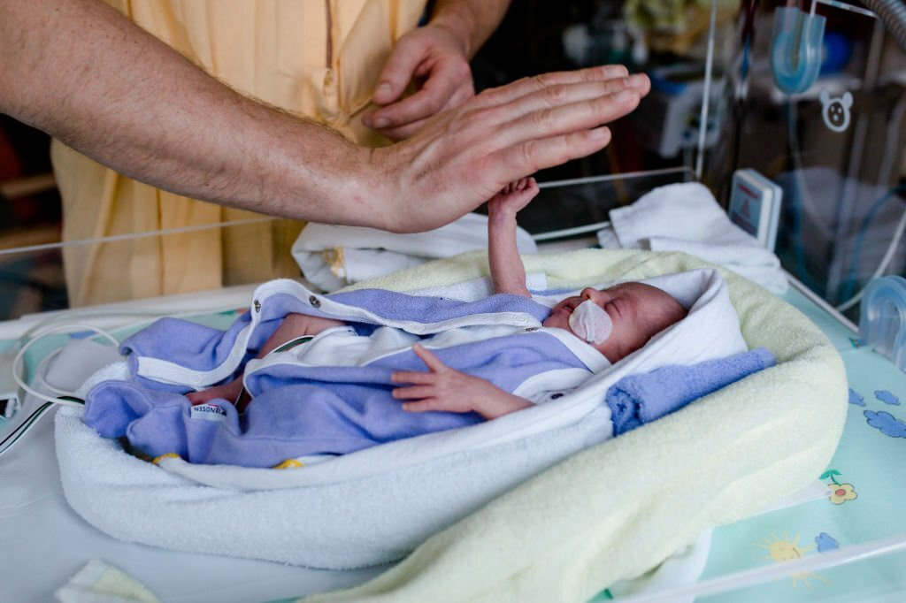
Thank you for giving us the opportunity to share our project with you!

